Slide 1
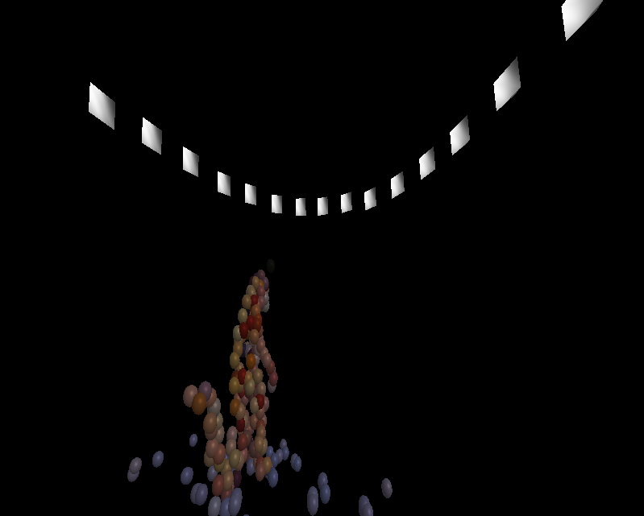
TSBB15 3D Reconstruction Group 2 “Epipolarna”

Slide 2
Modules
2D correspondence extraction – Alexander
Main program and pipeline – Mattias
Non-linear optimization – Martin
Visualization – Gustav

Slide 3
The 3D Reconstruction pipeline
Noisy, lots of false positives.
False positives are mostly isolated.
Easy to handle with later processing steps.

Slide 4
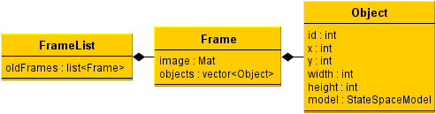
Data Structures
Object
Frame
Framelist

Slide 5
Main program
Uses a mixture of Gaussian model described by Wood.
Update procedure is slow... Close to 1 second per update on a larger image.

Slide 6
2D point extraction
Three main objectives:
Suppress shadows
Remove noise
Detect moving regions

Slide 7
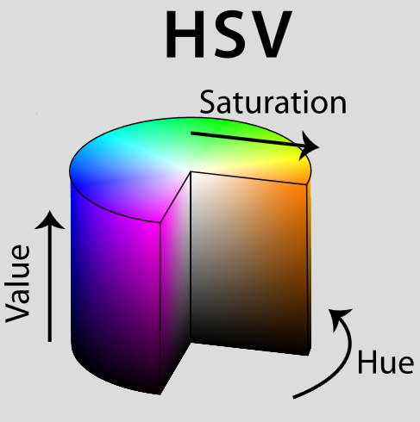
Estimation of F
Algorithm implemented as described in the master thesis by John Wood.
HSV mapping:
Easy to implement
Good performance
Few false positives
Problems with gray areas

Slide 8
Estimation of R and t
“Distance filtering”
Throw away foreground regions not thick enough
Good performance
Slow?
Implementation
cv::findContours, cv::pointPolygonTest
Iterate over bounding rectangle
Measure distance inside contour only
Final touch: some morphological dilate

Slide 9
Solving the PnP
Object creation
Find remaining contours
Create bounding boxes
Calculate positions

Slide 10
Identification
Objectives
Correlate previous objects with current objects
Handle occlusion
Objects <-> Objects
Objects <-> Background
Assign unique ID’s to new objects
Forget objects that leave the screen

Slide 11
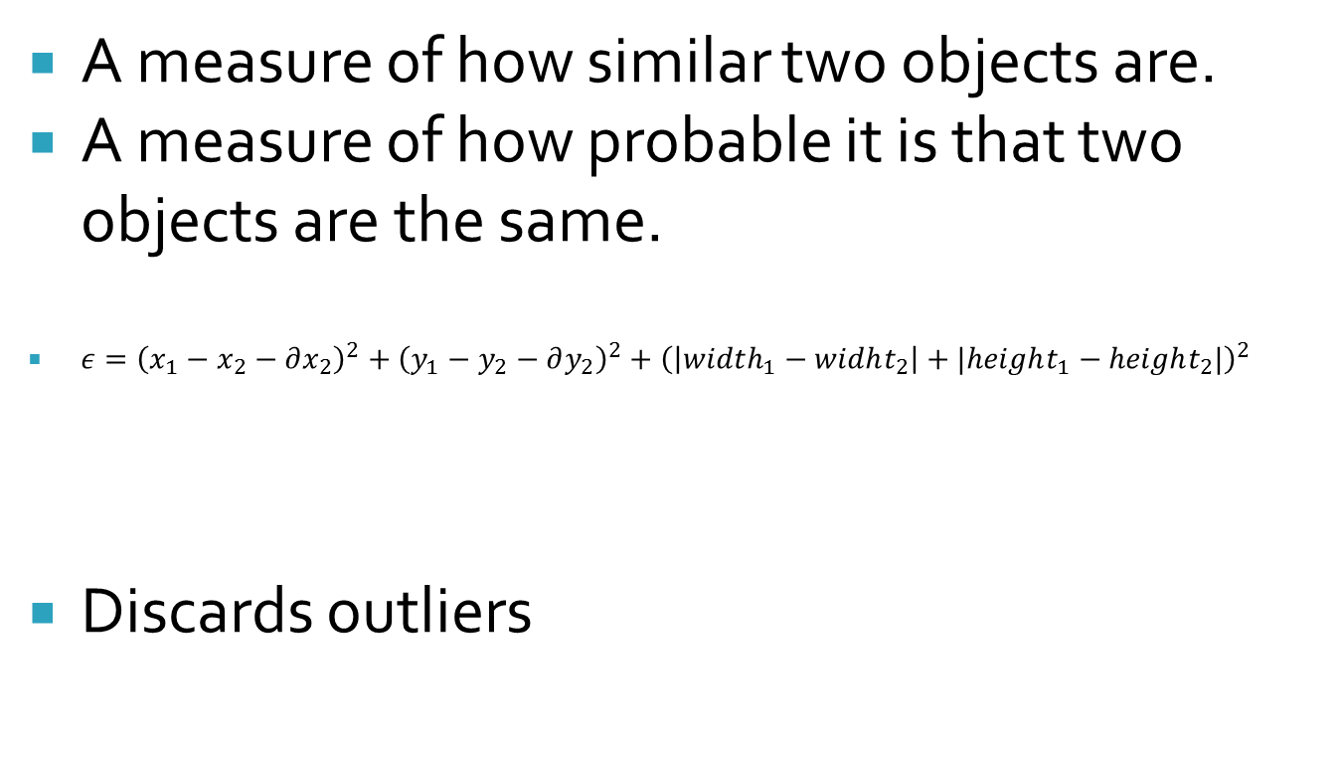
Identification – Error measure
A measure of how similar two objects are.
A measure of how probable it is that two objects are the same.
${ε=\left(x_{1}−x_{2}−∂x_{2}\right)}^{2}+{\left(y_{1}−y_{2}−∂y_{2}\right)}^{2}+{\left(\left|width_{1}−widht_{2}\right|+|height_{1}−height_{2}|\right)}^{2}$
Discards outliers
Squared euclidian distance
Squared size difference

Slide 12
Identification - Occlusion
Overlapping move
Non-overlapping move
1
2
Parent split
Sibling merge
3
4
Lost
Discovered
5
6

Slide 13
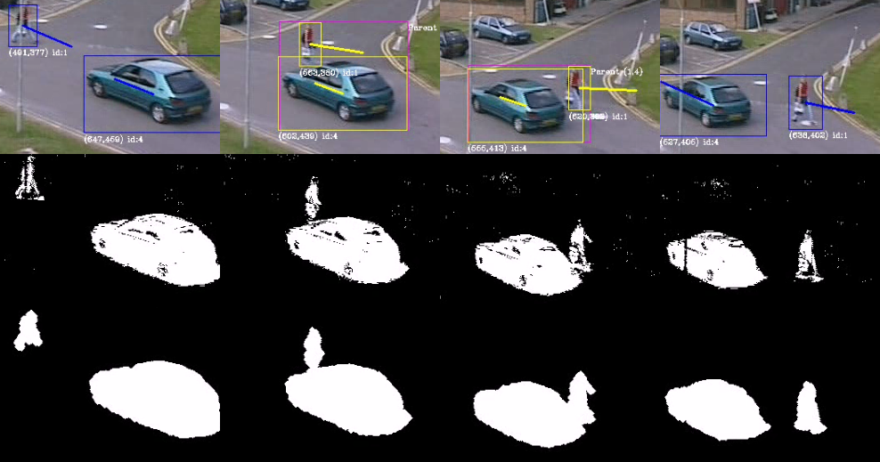
Identification – Occlusion

Slide 14
Identification - Improvements
Assumes all passed objects are ”real”
Large objects tends to collect lost heads, feets...
Width and Height should not change too fast...
The error function isn’t tuned at all: a change in width,height should probably impact more.
Objects should be removed if they have been lost for too long. Use the variance estimate from the kalman filter?

Slide 15
Prediction
Kalman: The optimal linear predictor
Components
State-Space Model
Covariance Matrices
Difficulties
Smoothing

Slide 16
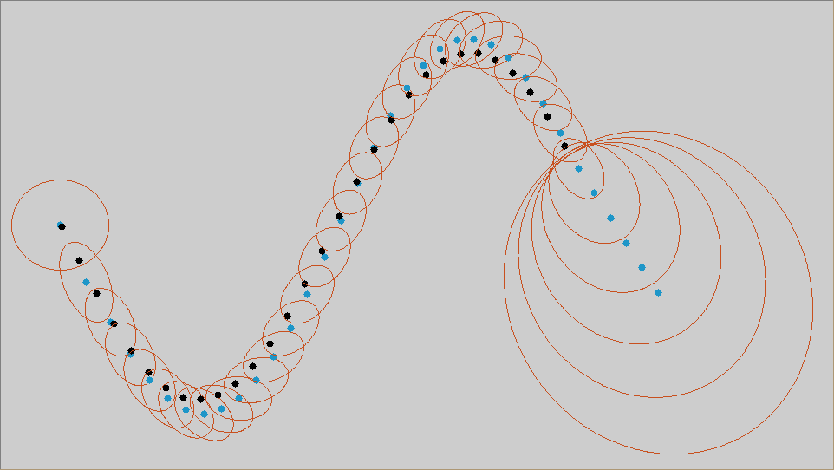
Prediction

Slide 17
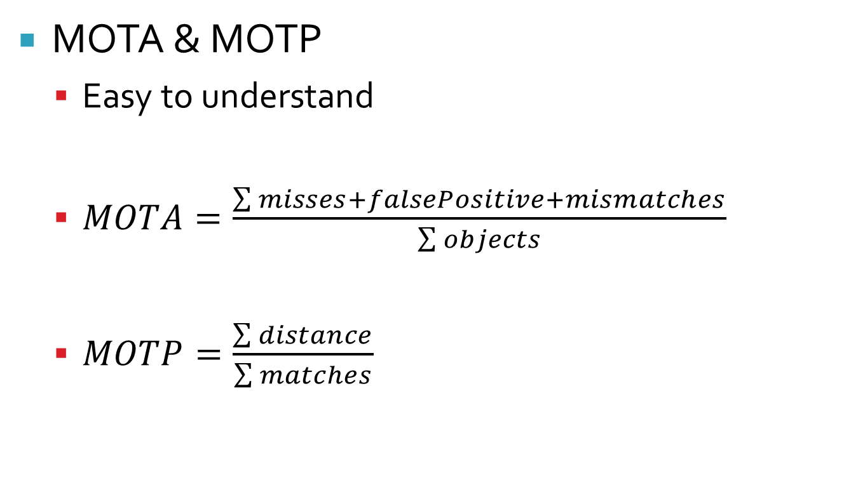
Evaluation
MOTA & MOTP
Easy to understand
$MOTA=\frac{\sum{misses+falsePositive+mismatches}}{\sum{objects}}$
$MOTP=\frac{\sum{distance}}{\sum{matches}}$

Slide 18
Evaluation
Improvement
No area evaluation
Get rid of the threshold

Slide 19
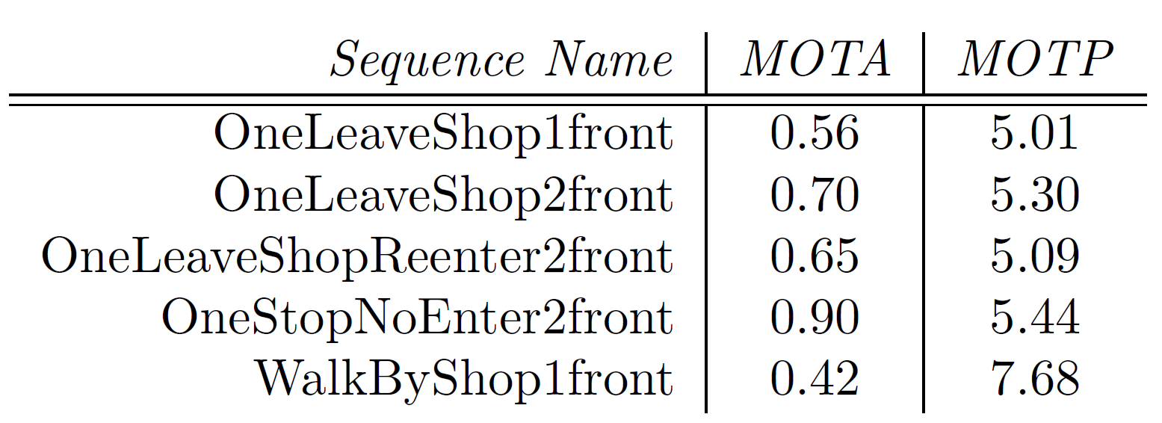
Results

